Slide 1
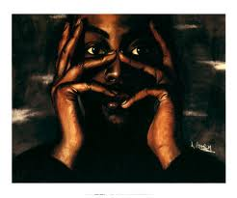
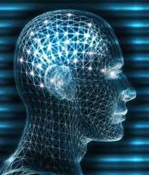
Thoughts
Learning to take control of our thoughts, imaginations, and emotions.

Slide 2
Thoughts
Why Our mind is important
Our thoughts determine our actions. Actions develop into behavior. Behavior forms lifestyle.
Our thoughts affect our emotions/moods/feelings. Our emotions affect our spiritual, mental and physical states.
Our imaginations can either energize or impair us.

Slide 3
Thoughts
Some Mind Problems
Fear
Lack of concentration
Confusions
Poor self-image (low self esteem)
Denial, Deceptions and Incorrect reasonings
Strongholds leading to compulsive behavior
Diseases of the mind—depression, mania, schizophrenia, etc.

Slide 4
Thoughts
Demonic Darts
Deceptions
Accusations
Temptations

Slide 5
Thoughts
The Process of Temptation
Thought
Imagination
Affects emotions, weakens will
Influences action
Reasonings that defend the action
Accepted practice
Stronghold of the mind

Slide 6
Thoughts
Taking Action in the Mind
1 Peter 1:13
“So roll up your sleeves, put your mind in gear,...”

Slide 7
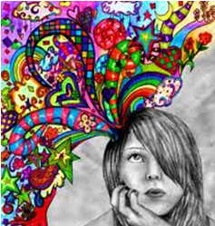
Thoughts
Taking Action in the Mind
Take control of your mind. Your mind is your business.
My mind is mine.
I will decide what thoughts
should go on in my mind.
I refuse to allow my mind
to wander aimlessly.

Slide 8
Thoughts
Taking Action in the Mind
Philippians 4:8
“Summing it all up, friends, I'd say you'll do best by filling your minds and meditating on things true, noble, reputable, authentic, compelling, gracious--the best, not the worst; the beautiful, not the ugly; things to praise, not things to curse.”

Slide 9
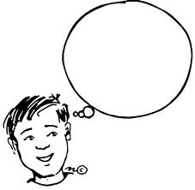
Thoughts
Taking Action in the Mind
Avoid passivity. Do not keep your mind blank.
An idle mind becomes the devil’s workshop.

Slide 10
Thoughts
How to take action : RSVP
Reject wrong thoughts, imaginations and feelings with the Word of God
Speak the Word of God over your mind
Visualize the Word of God, positive things, etc.
Pray and protect your mind – ask God for help to keep a pure mind

Slide 11
Thoughts
A, Taking Control of Your Mind—Fighting Evil Desires
James 1:13-16 (NKJV)
13 Let no one say when he is tempted, "I am tempted by God"; for God cannot be tempted by evil, nor does He Himself tempt anyone.
14 But each one is tempted when he is drawn away by his own desires and enticed.
15 Then, when desire has conceived, it gives birth to sin; and sin, when it is full-grown, brings forth death.
16 Do not be deceived, my beloved brethren.

Slide 12
Thoughts
A, Taking Control of Your Mind—Fighting Evil Desires
Galatians 5:24 (NKJV)
And those who are Christ's have crucified the flesh with its passions and desires.

Slide 13
Thoughts
A, Taking Control of Your Mind—Fighting Evil Desires
Whatever you feed, grows. Whatever you starve, dies.
Starve the ‘fleshly lusts’, the ungodly desires of your body and mind.

Slide 14
Thoughts
B, Taking Control of Your Mind—Fighting Demonic Darts
2 Corinthians 10:4-5
For the weapons of our warfare are not carnal but mighty in God for pulling down strongholds, casting down arguments and every high thing that exalts itself against the knowledge of God, bringing every thought into captivity to the obedience of Christ,

Slide 15
Thoughts
B, Taking Control of Your Mind—Fighting Demonic Darts
Understand your mind is yours.
Judge or evaluate every thought, every reasoning and every imagination in the light of Scripture. Discern, Discipline and Deal with every thought.

Slide 16
Thoughts
B, Taking Control of Your Mind—Fighting Demonic Darts
Speak the Word into your own mind. For every negative thought you may need ten positive thoughts to get rid of it.
Paint new pictures in your mind. Create new pictures and imaginations based on the Word of God, concerning every area of your life.

Slide 17
Thoughts
C, Taking Control of Your Mind-Fighting Negative Words That People Speak
We must develop the ability to receive or reject what people say.
Words that people speak can either bless or hurt our mind, will and emotions.

Slide 18
Thoughts
C, Taking Control of Your Mind-Fighting Negative Words That People Speak
Counteract negative words that people speak, with what God has already spoken about you. “I am who God says I am, I can do what God says I can do, I will become everything God has promised!”

Slide 19
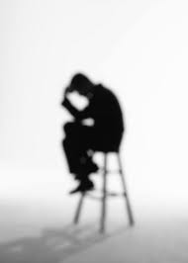
Thoughts
C, Taking Control of Your Mind-Fighting Negative Words That People Speak
Receive healing from God for emotional hurts and wounds that have come through traumatic or unpleasant experiences.

Slide 20
Thoughts
C, Taking Control of Your Mind-Fighting Negative Words That People Speak
Psalm 23:3
He restores my soul;

Slide 21
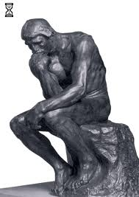
Thoughts
D, Taking Control of Your Mind-Overcoming Fear, Worry & Anxiety
Isaiah 26:3
You will keep him in perfect peace, Whose mind is stayed on You, Because he trusts in You.

Slide 22
Thoughts
D, Taking Control of Your Mind-Overcoming Fear, Worry & Anxiety
To walk in perfect peace you must discipline your mind to rest, rely on the Lord.
You must maintain thoughts that
express your dependence on the
Lord and on outcomes resulting
from your dependence on the Lord.

Slide 23
Thoughts
D, Taking Control of Your Mind-Overcoming Fear, Worry & Anxiety
Philippians 4:6,7
Be anxious for nothing, but in everything by prayer and supplication, with thanksgiving, let your requests be made known to God;
and the peace of God, which
surpasses all understanding, will
guard your hearts and minds
through Christ Jesus.

Slide 24
Thoughts
D, Taking Control of Your Mind-Overcoming Fear, Worry & Anxiety
Through prayer you can exchange your anxieties for His peace that will garrison your heart and mind.
You can lay your burdens down at His feet through prayer. Pause, pray and exchange your worries for His peace.

Slide 25
Thoughts
E, Taking Control of Your Mind - Pulling Down Strongholds
Pulling down strongholds needs a bit more work.
Thoughts, arguments and imaginations come and go through the mind everyday. But strongholds have been built over a period of time.

Slide 26
Thoughts
E, Taking Control of Your Mind - Pulling Down Strongholds
Repent. Repentance simply means a change in your thinking. Start thinking differently. Submit that area to God.
Reject (Resist) corresponding demonic spirits that
may have gained entrance. 23:29).

Slide 27
Thoughts
E, Taking Control of Your Mind - Pulling Down Strongholds
Renounce every activity that would have opened doors to demonic influences.
Remove the bricks. A stronghold is a ‘house’ made up of thoughts. Each one of these bricks that are built in the stronghold has to be dislocated and removed with the Word. God’s Word is like a hammer that breaks them down (Jeremiah 23:29).

