Slide 1
Work Smart
Keys to improving personal efficiency and productivity

Slide 2
Work Smart
Keys to improving personal efficiency and productivity
Why improve personal efficiency & productivity?

Slide 3
Manage time properly
Work Smart
Keys to improving personal efficiency and productivity
Ephesians 5:15-17
¹⁵ See then that you walk circumspectly, not as fools but as wise,
¹⁶ redeeming the time, because the days are evil. ¹⁷ Therefore do not be unwise, but understand what the will of the Lord is.

Slide 4
Improve key skills
Work Smart
Keys to improving personal efficiency and productivity
Ecclesiastes 10:10
If the axe is dull, And one does not sharpen the edge, Then he must use more strength; But wisdom brings success.

Slide 5
Use tools & smart tricks
Work Smart
Keys to improving personal efficiency and productivity
Avoid doing the same thing twice - reuse. Plan for reuse.
Organize/File things intuitively for easy retrieval
Use your best time for most important/demanding tasks
Break big tasks up so that you finish the longest part first

Slide 6
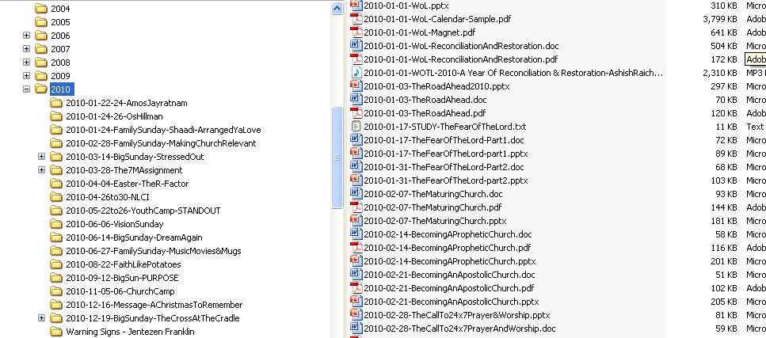
Work Smart
Keys to improving personal efficiency and productivity
Organize/File things intuitively for easy retrieval

Slide 7
, Staying mentally and physically fit
Work Smart
Keys to improving personal efficiency and productivity
Mark 1:35
Now in the morning, having risen a long while before daylight, He went out and departed to a solitary place; and there He prayed.

Slide 8
Leverage team work & delegation
Work Smart
Keys to improving personal efficiency and productivity
Ecclesiastes 4:9
Two are better than one, Because they have a good reward for their labor.

Slide 9
Develop your Inspiration Quotient (IQ) - supernatural wisdom & revelation
Work Smart
Keys to improving personal efficiency and productivity
God can inspire ideas that will save your time, energy and resources.

Slide 10
Welcome the God Factor
Work Smart
Keys to improving personal efficiency and productivity
Jacob -Genesis 30:25-43
Gideon- Judges 7

