Slide 1
GOD STEPS INTO OUR MESS

Slide 2
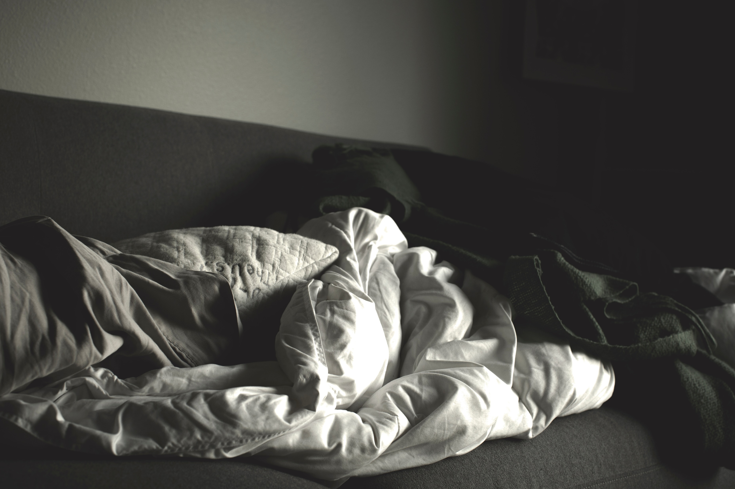
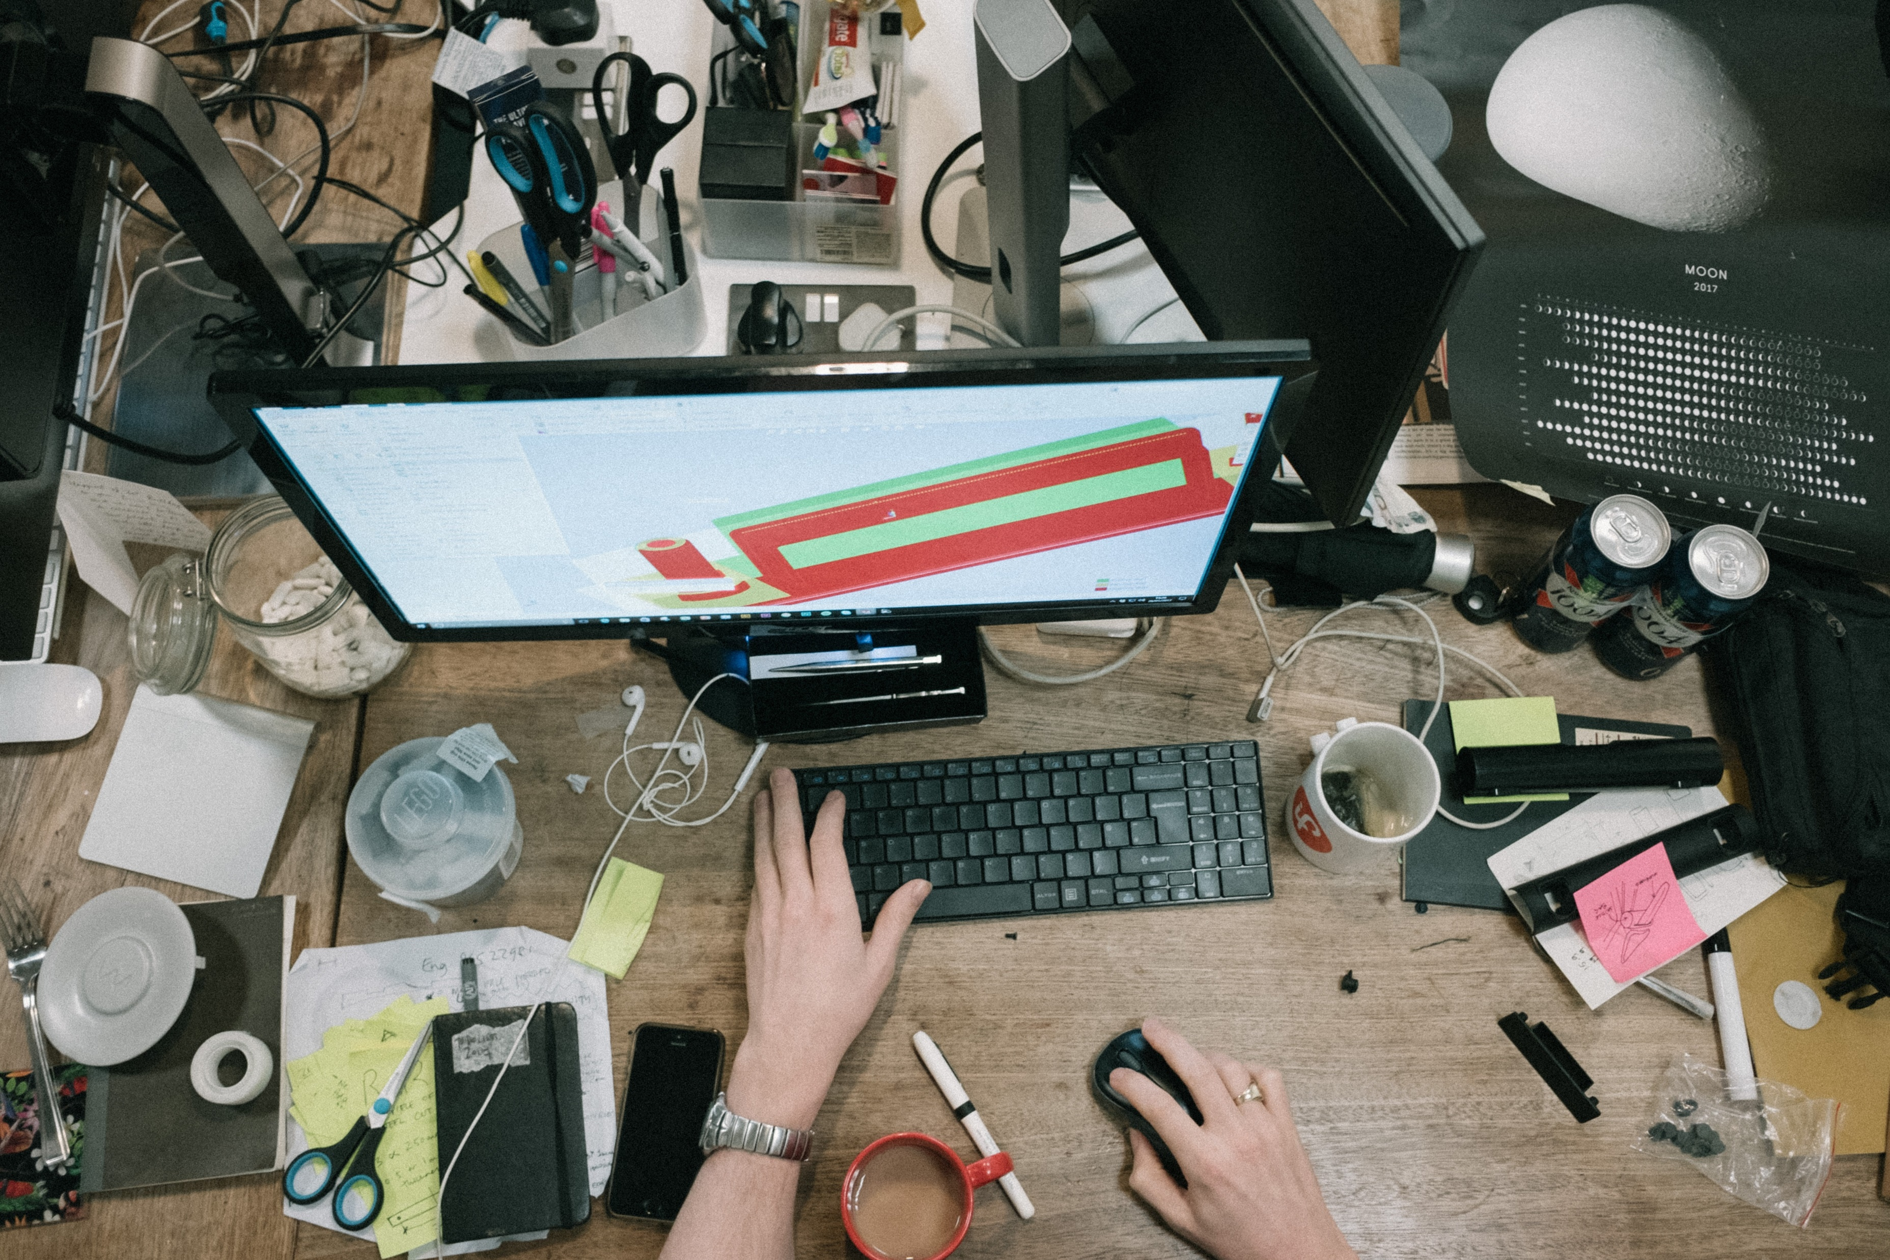
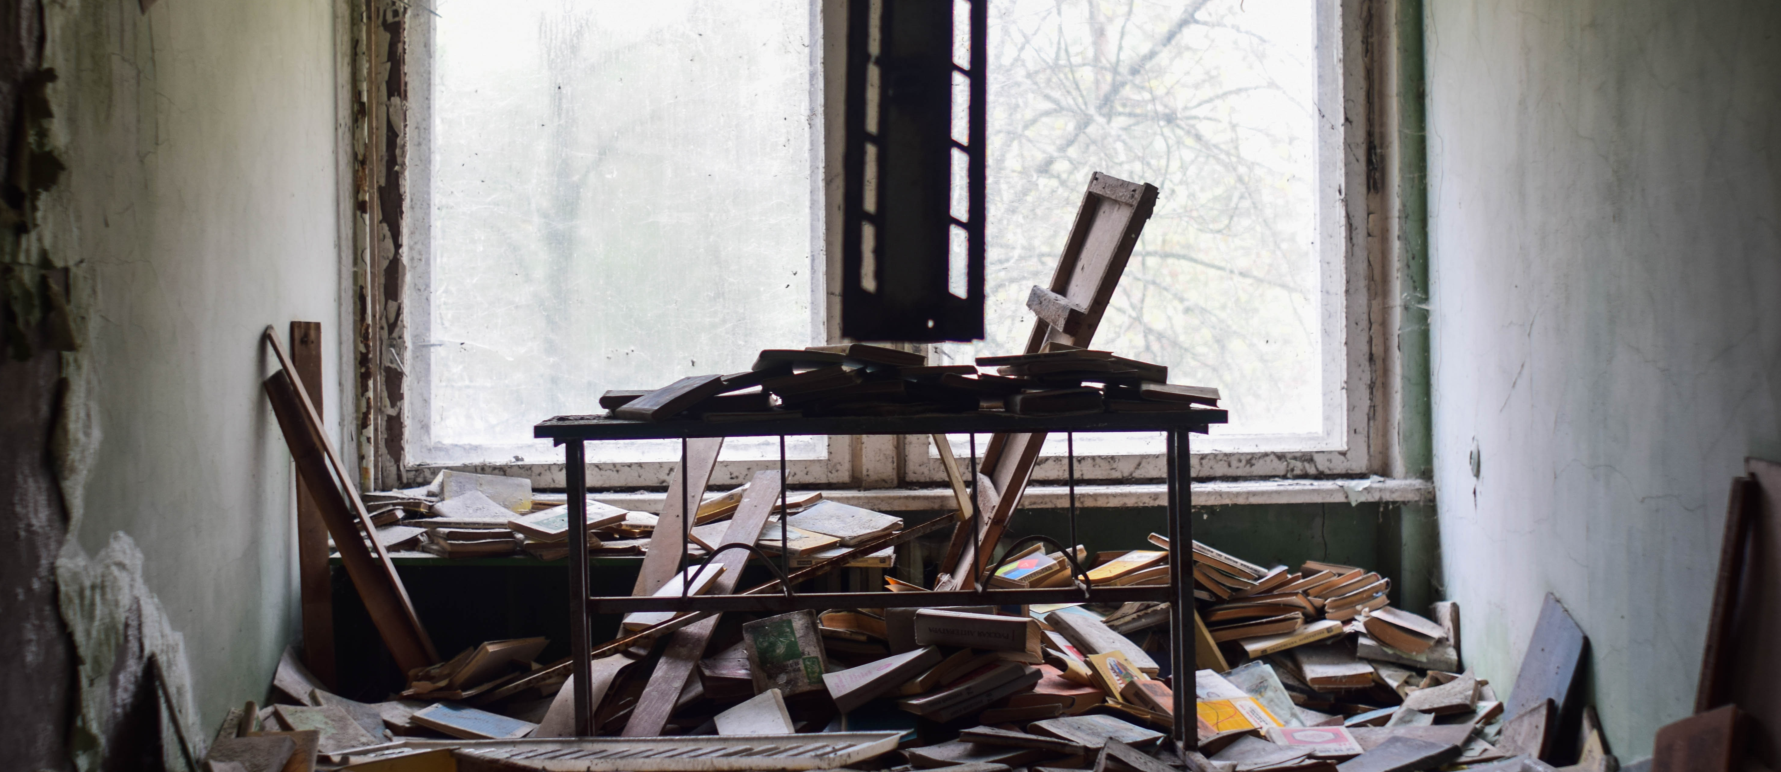
IMAGINE

Slide 3
Suffering - Our Unhappy Reality
Regrets
Broken relationships
Unhappy families
Difficult situations
Painful experiences

Slide 4
Where Did It All Begin?
Adam and Eve
Rejected God’s love
Hardship and pain entered in
All creation was affected
Romans 8:22a (NIV) We know that the whole creation has been groaning as in the pains of childbirth right up to the present time.

Slide 5
The Effects of Suffering
Eats away our joy and peace
Brings us down
Makes us exhausted ALL THE TIME

Slide 6
A.S.K.
Admit the truth
Seek help
Know there is hope
God made you – He loves you and created you with great purpose.
God in His great love for us, does not leave us alone when we suffer.

Slide 7
Emmanuel – God With Us
Phil 2:7-8a MSG When the time came, he set aside the privileges of deity and took on the status of a slave, became human! Having become human, he stayed human. It was an incredibly humbling process. He didn’t claim special privileges.

Slide 8
What is the mess you’re in?

Slide 9
In the midst of our mess…
God our Father gives us hope
Hope that we will see better days
Hope that God will fight our battles for us

