Slide 1
The Final Exam

Slide 2

Exams!

Slide 3
What If Life Ends With A Final Exam?
How many of us would pass and graduate?
What are the questions we will be asked in this exam?
What is the minimum score required to pass?
How can we prepare now?

Slide 4
Here’s What We Graduate To!
“Look, God’s home is now among his people! He will live with them, and they will be his people. God himself will be with them. He will wipe every tear from their eyes, and there will be no more death or sorrow or crying or pain. All these things are gone forever.”
And the one sitting on the throne said, “Look, I am making everything new!” And then he said to me, “Write this down, for what I tell you is trustworthy and true.”
Revelation 21:3b-6 (NLT)

Slide 5
Here’s What We Graduate To!
No longer will there be a curse upon anything.
And there will be no night there—no need for lamps or sun—for the Lord God will shine on them.
Revelation 22:3a, 5a (NLT)

Slide 6
Is There Life After Death?
YES
NO

Slide 7
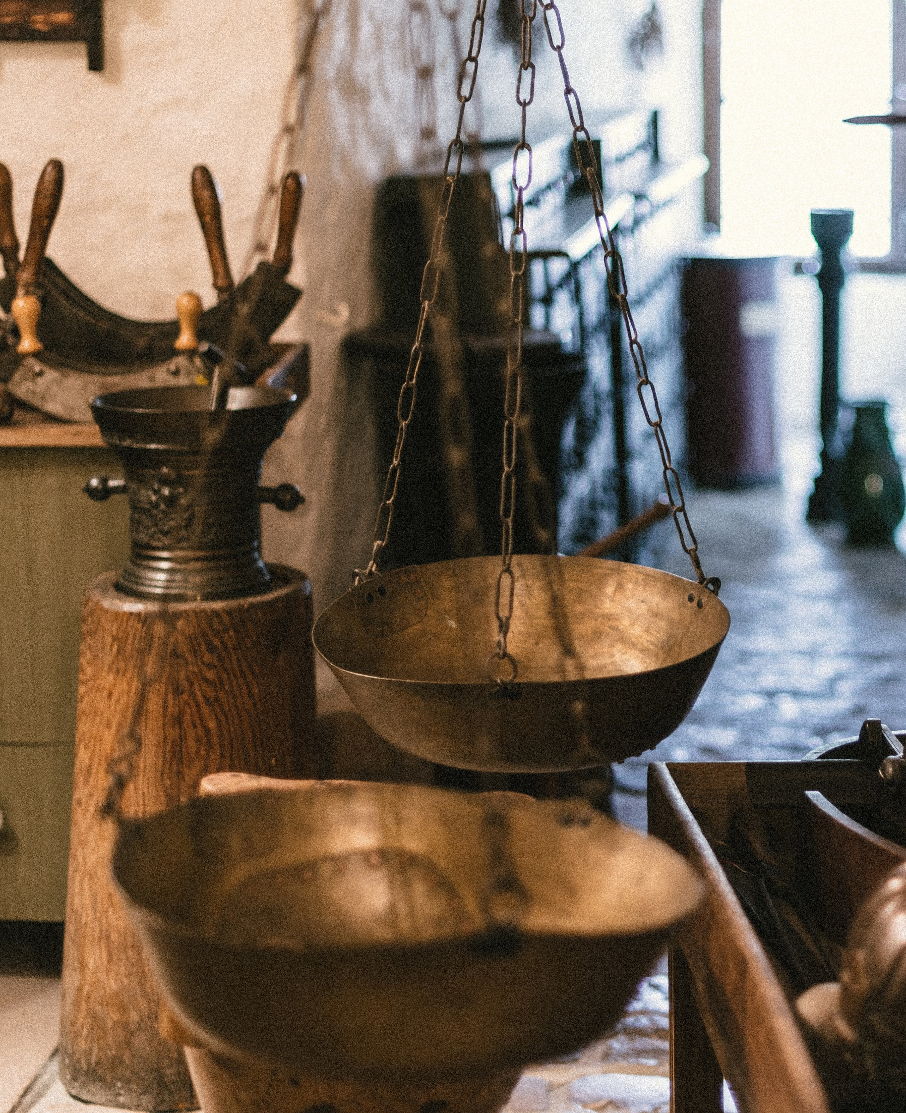
What Questions Will We Be Asked?
I have swept away your sins like a cloud. I have scattered your offenses like the morning mist. Oh, return to me, for I have paid the price to set you free.
Isaiah 44:22 (NLT)
Good
Bad

Slide 8
What Is The Pass Mark?
“You have heard that it was said to the people long ago, ‘You shall not murder, and anyone who murders will be subject to judgment.’ But I tell you that anyone who is angry with a brother or sister will be subject to judgment.
“You have heard that it was said, ‘You shall not commit adultery.’ But I tell you that anyone who looks at a woman lustfully has already committed adultery with her in his heart.
Matthew 5:21-22a, 27-28 (NIV)

Slide 9
Complete Purity
This is why Jesus says, "I am the way and the truth and the life. No one comes to the Father except through me.”
John 14:6 (NIV)
No one else in history claims that they can make us completely pure and able to enter God’s presence.

Slide 10
How Can We Prepare Now?
We decide whether we want this gift Jesus offers.
And God, the one sitting on the throne also said, “It is finished! I am the Alpha and the Omega—the Beginning and the End. To all who are thirsty I will give freely from the springs of the water of life. All who are victorious will inherit all these blessings, and I will be their God, and they will be my children.
Revelation 21:6-7 (NLT)

