Slide 1
SUCCESS
TRUE

Slide 2
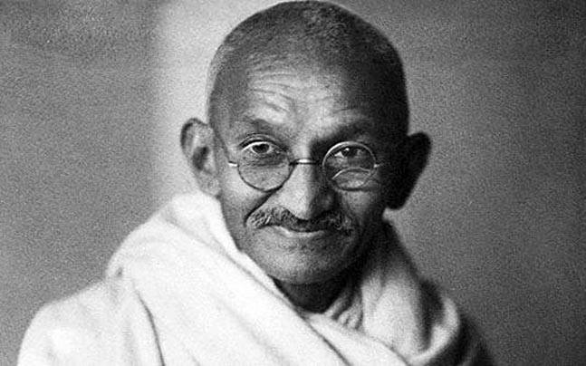
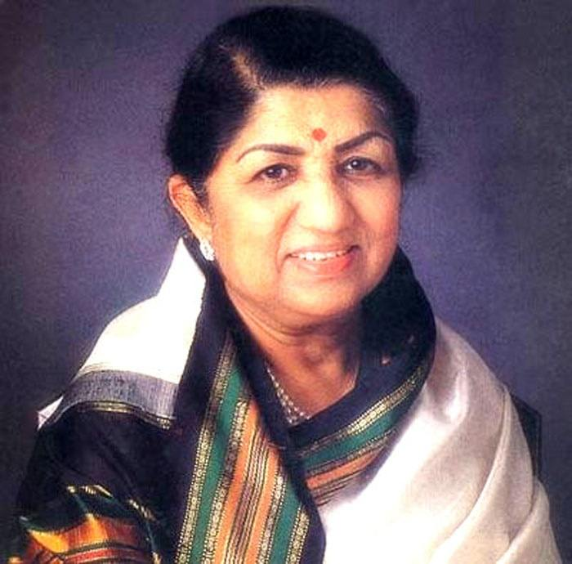
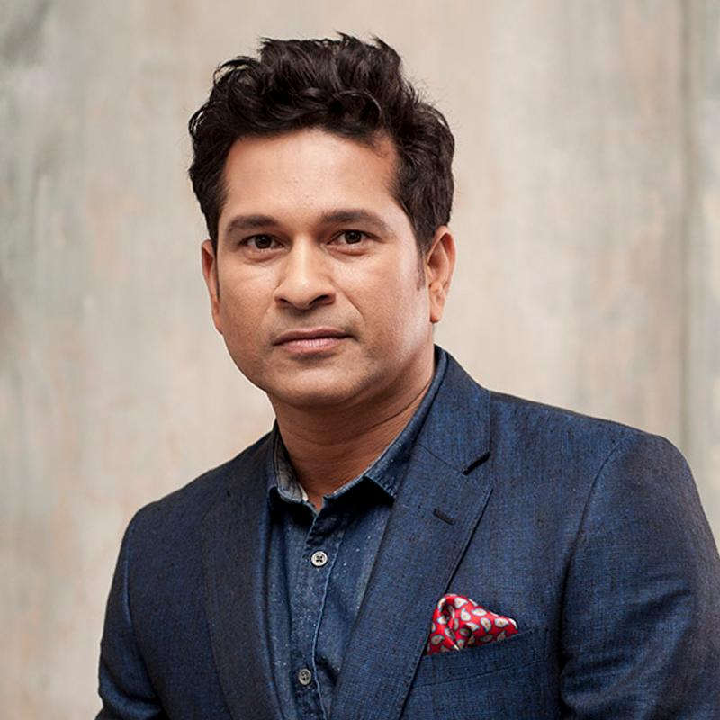
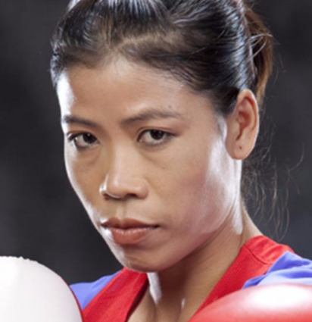

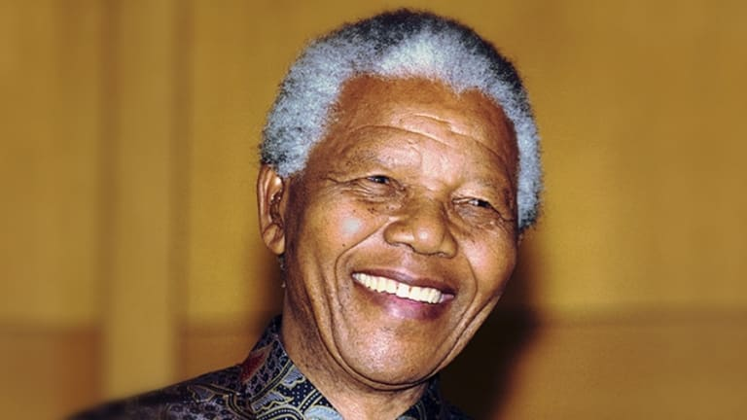

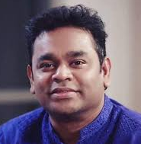
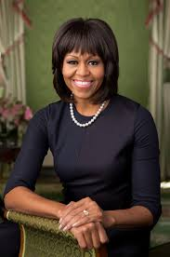
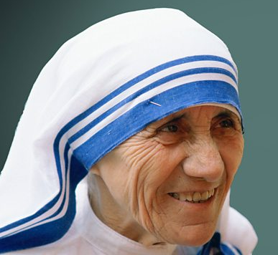
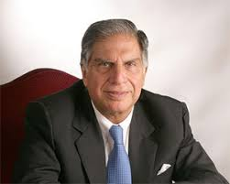

Slide 3

What is Success?
A basic definition –
The achievement of goals which a person sets out to accomplish
Therefore,
A person is said to have succeeded in life when they accomplish their life goal.

Slide 4
Setting a Life Goal
Without a goal, we will follow any path. It doesn’t matter which one we choose.
Notes:
Alice in wonderland (youtube video) - https://www.youtube.com/watch?v=7ISenpl1R94

Slide 5
The Story of an Unlikely Hero
Born in an obscure village
Worked as a carpenter
Never got a degree, never wrote a book, never held a public office, never married and had a family, nor owned a home.
Yet, great crowds followed Him. He healed the sick, cast out impure spirits, calmed raging seas, multiplied food to feed the hungry and preached an unseen Kingdom

Slide 6
Lessons from the Life of Jesus
Matthew 3:13-17 (NLT)
Then Jesus went from Galilee to the Jordan River to be baptized by John. But John tried to talk him out of it. “I am the one who needs to be baptized by you,” he said, “so why are you coming to me?”
But Jesus said, “It should be done, for we must carry out all that God requires.” So John agreed to baptize him.
After his baptism, as Jesus came up out of the water, the heavens were opened and he saw the Spirit of God descending like a dove and settling on him. And a voice from heaven said, “This is my dearly loved Son, who brings me great joy.”

Slide 7
Key Ingredients for a Successful Life
1. Stay faithful to the will of God
2. Have the power of God
3. Receive your true identity from God

Slide 8
Stay faithful to the will of God
“A means to an end”
What methods do we use to reach our desired goals?

Slide 9
Have the Power of God
The first step to knowing God is acknowledging that we are not God.
John 15:5 (NLT) Jesus said, “Yes, I am the vine; you are the branches. Those who remain in me, and I in them, will produce much fruit. For apart from me you can do nothing.”
Matt 19:26 (NLT) Jesus looked at them intently and said, “Humanly speaking, it is impossible. But with God everything is possible.”

Slide 10
Receive your true identity from God
When our identity is secure in God, we will have greater focus on what is most important.

Slide 11
Lessons from the Life of Jesus
It is Finished!
Eph 2:10 (NLT) For we are God’s masterpiece. He has created us anew in Christ Jesus, so we can do the good things he planned for us long ago.

