Slide 1
Who? Why?

Slide 2
Who? Why?
Does my life have any meaning ?
Where am I going from here?
What is the purpose of my life?
Why do I exist?
Who am I?

Slide 3
Who? Why?
Is it only about your happiness?
Is it about a fatalist approach- eat, drink and be merry?
Is just physical or intellectual satisfaction enough?
A meaningless life?

Slide 4
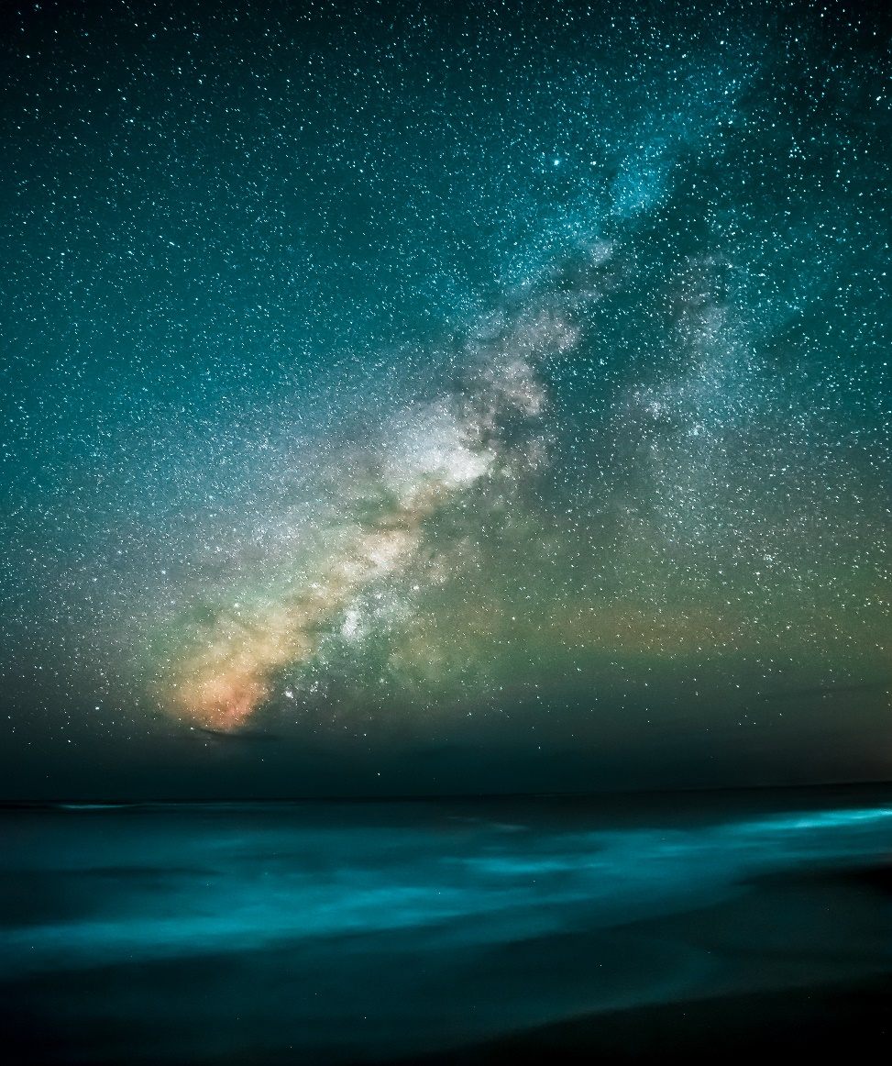
The Reality Of God
All of creation, the entire universe is nothing but a huge signpost saying God is real.
He has designed everything and He has a purpose for all that He created.

Slide 5
The Reality of God
Romans 1:20 (MSG)
By taking a long and thoughtful look at what God has created, people have always been able to see what their eyes as such can't see: eternal power, for instance, and the mystery of his divine being. So nobody has a good excuse.

Slide 6
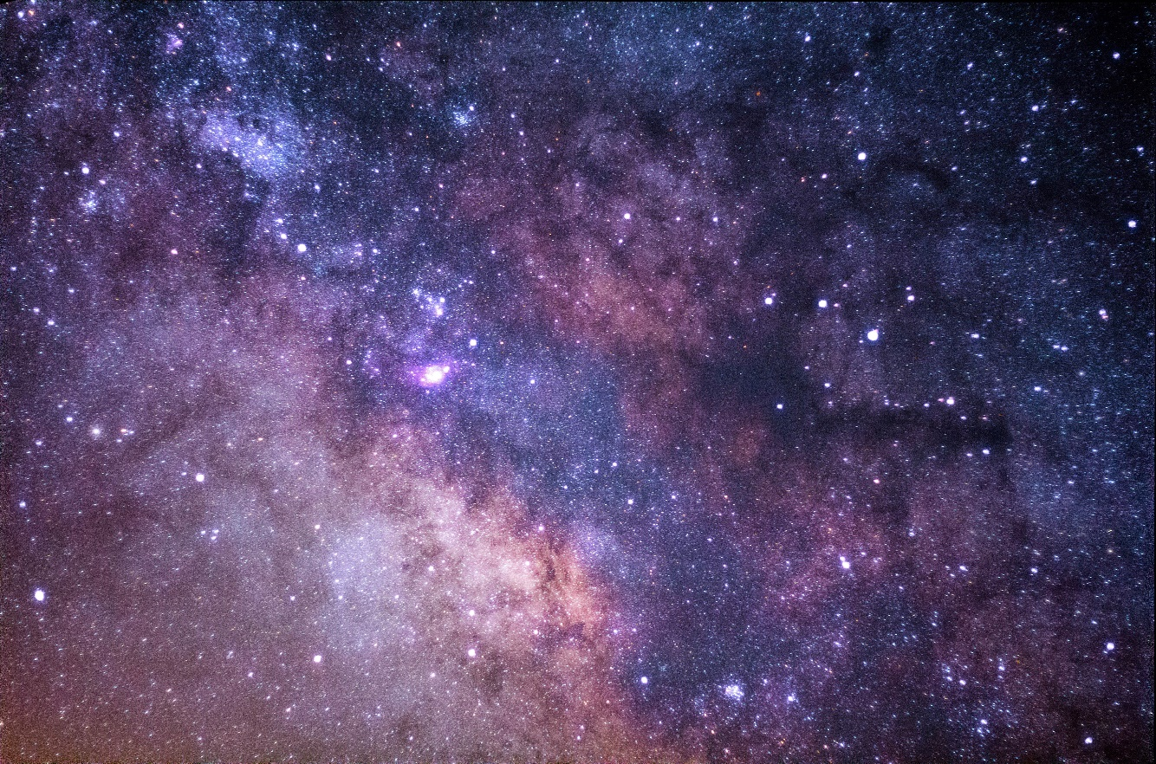
God, our Creator is Infinitely Great
Psalm 147:4,5 (NLT)
He counts the number of the stars; He calls them all by name.
Great is our Lord, and mighty in power; His understanding is infinite.

Slide 7
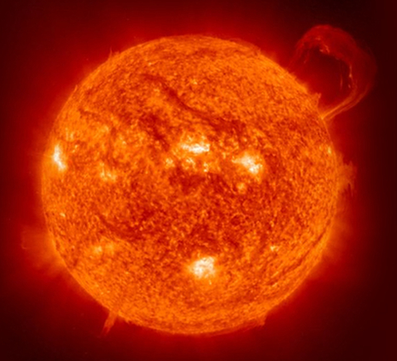
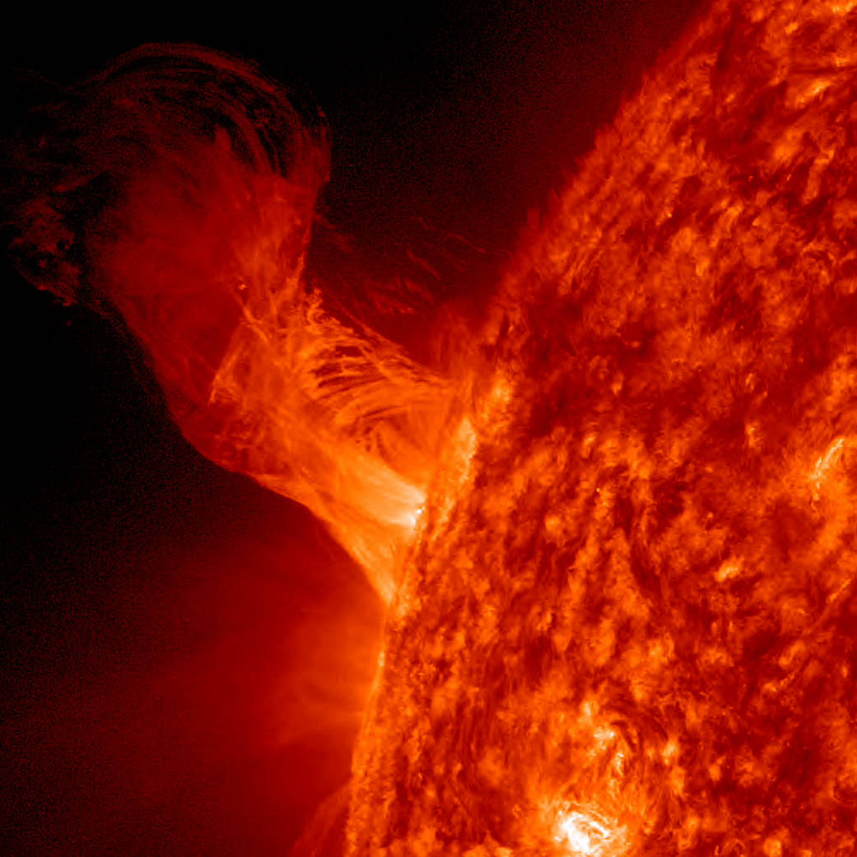
The heavens proclaim the glory of God. The skies display his craftsmanship. Day after day they continue to speak; night after night they make him known. Psalm 19:1-2 (NLT)

Slide 8
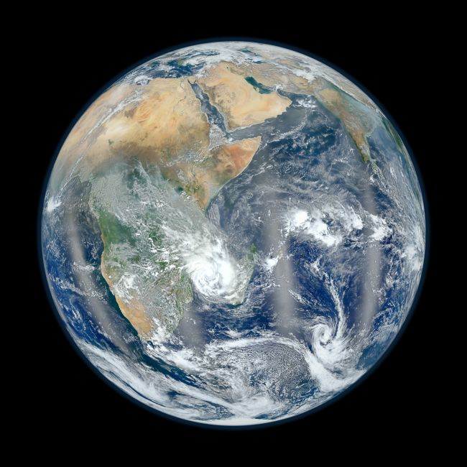
Our home!

Slide 9
You are special!
You were created, uniquely designed by God for a purpose here on earth!
You are God's Masterpiece. You are God's handiwork. You were designed in God's own image.
Psalm 139:13,14
For You formed my inward parts; You covered me in my mother's womb.
I will praise You, for I am fearfully and wonderfully made; Marvelous are Your works, And that my soul knows very well.

Slide 10

Two main purposes for which God created you
1. for YOU to personally relate to God
Adam was created as part of God’s family (Luke 3:38)
God does not want you to have a morbid, unhealthy fear of Him – but He wants you to relate to Him as a son or a daughter of God.
2. for YOU to personally represent God
Adam was created to represent God on earth (Genesis 1:26)

Slide 11

You are loved!
But to all who believed him and accepted him, he gave the right to become children of God. (John 1:12, NLT)
A personal relationship with God is possible because of Jesus.
The meaning of life begins when you meet with the Creator of life –
The Lord Jesus Christ.

